Slide 1
Your College Selection Journey
2019-2020
ROAD
COLLEGE
to

Slide 2
Schedule College Counselor Meeting
Write Personal Statements/College Essays
Build College List (1 Reach, 1 Target, 1 Safety to start) | Due 30 August

Slide 3
Request Letters of Recommendation
Apply for Scholarships,(QuestBridge, Gates Millennium, etc.)
Schedule Personal Statement Feedback Meeting

Slide 4
Finalize
College List
2 Reach + 4 Target + 2 Safety = 8 Possibilities (or more)
Submit
Early Decision (Binding, 1 College Only) and Early Action Applications (Non-Binding)
Secure
FAFSA Pins

Slide 5
Attend
Financial Aid Parent Night
Gather
Information for FAFSA and TASFA
Submit
Scholarship Applications
(Jack Kent Cooke, Terry Foundation, Dell, etc.)

Slide 6
Submit College Admission Applications
Participate in College March
8 Dec.
Submit Admission Decision and Scholarship Award Letters | Due: 20 Dec.

Slide 7
Submit FAFSA and TASFA Applications for Financial Aid
Review Senior College Checklist Midterm Report

Slide 8
Submit Final
Community College
Applications
Attend Career Exploration
Field Trips

Slide 9
Accept
Financial Aid Award
Submit
Final Scholarship Applications
Submit
Student Aid Reports and Scholarship Award Letters

Slide 10
Submit Final Admission Decisions
Participate in College Signing Day
Attend Financial Aid Award Meetings

Slide 11
Take AP & IB Exams
Congratulations! Attend Graduation Meetings
Attend Senior Week & Senior Banquet

Slide 12
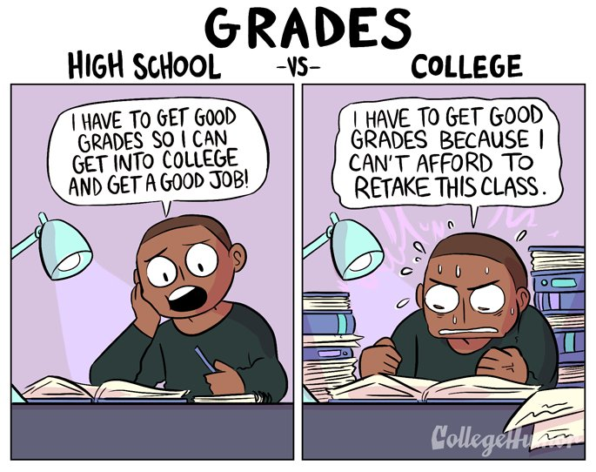
Finalize Housing if Needed
Submit Final Transcripts
Pay Tuition and Fees
Attend College Orientation
Prep for the 1st Day of Class!

